Slide 1




ONTARIOTECHUCAR4U

Slide 2
Objective & Goal
Provide the simplest way for students to rent out their car or book cheap rental cars right on their smartphone devices.
Provide easier, cheaper transportation alternatives to university student.

Slide 3
What
Does CAR4U DO?
-Create an account
-List your car for rent
-Search a car for rent
-Book a car for rent
-History of previous bookings
-List of your car postings

Slide 4
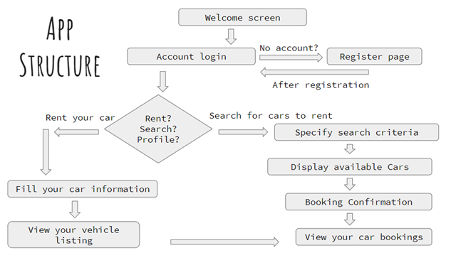

Slide 5
Database
The application maintains an online centralized Database of all the accounts created/registered. As well as a local database of personal activities.

Slide 6

DEMONSTRATION

Slide 7
Questions?

